Slide 1



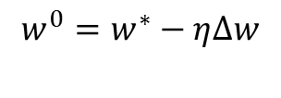
Node 1
Back-propagation
OpenMP/CUDA for BLAS
Node 0: Host ( )
AdaGrad or PSO
Node 2
Node 3
……
Node 6
Node 7

